Slide 1
Unified Software Development Process

Slide 2
USDP
The Unified Software Development Process or Unified Process is a popular iterative and incremental software development process framework.
The best-known and extensively documented refinement of the Unified Process is the Rational Unified Process (RUP).
Other examples are OpenUP and Agile Unified Process.
The Unified Process is not simply a process, but rather an extensible framework which should be customized for specific organizations or projects.
The Rational Unified Process is, similarly, a customizable framework.
As a result it is often impossible to say whether a refinement of the process was derived from UP or from RUP, and so the names tend to be used interchangeably.

Slide 3
USDP
The Unified Process (UP) is a use-case-driven, architecture-centric, iterative and incremental development process framework that leverages the Object Management Group's (OMG) UML and is compliant with the OMG's SPEM.
The process consists of four main phases: inception, elaboration, construction and transition.
Each of these contains one or more iterations across five core workflows: requirements, analysis, design, implementation and test.
The UP is broadly applicable to different types of software systems , including small-scale and large-scale projects having various degrees of managerial and technical complexity, across different application domains and organizational cultures.
The UP is an "idea," a process framework that provides an infrastructure for executing projects but not all of the details required for executing projects; essentially, it is a software development process framework, a lifecycle model involving context, collaborations, and interactions.

Slide 4
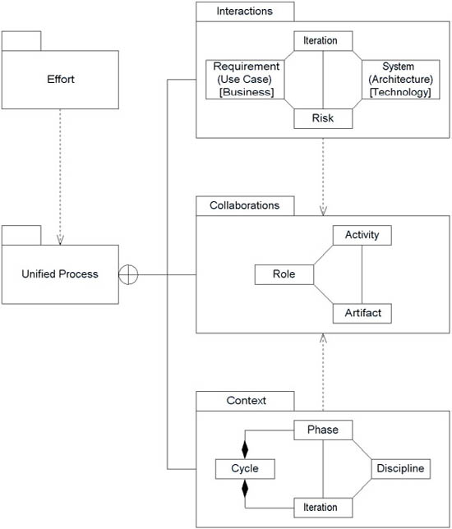
Elements of UP

Slide 5
Characteristics of UP
Iterative and Incremental
The Unified Process is an iterative and incremental development process.
The Elaboration, Construction and Transition phases are divided into a series of time boxed iterations.
The Inception phase may also be divided into iterations for a large project.
Each iteration results in an increment, which is a release of the system that contains added or improved functionality compared with the previous release.
Although most iterations will include work in most of the process disciplines (e.g. Requirements, Design, Implementation, Testing) the relative effort and emphasis will change over the course of the project.

Slide 6
Characteristics of UP
Architecture Centric
The Unified Process insists that architecture sit at the heart of the project team's efforts to shape the system.
Since no single model is sufficient to cover all aspects of a system, the Unified Process supports multiple architectural models and views.
One of the most important deliverables of the process is the executable architecture baseline which is created during the Elaboration phase.
This partial implementation of the system serves to validate the architecture and act as a foundation for remaining development.
Risk focused
The Unified Process requires the project team to focus on addressing the most critical risks early in the project life cycle.
The deliverables of each iteration, especially in the Elaboration phase, must be selected in order to ensure that the greatest risks are addressed first.

Slide 7
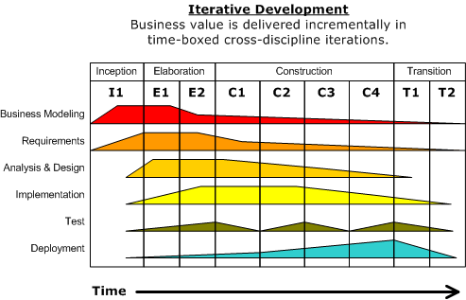

Slide 8
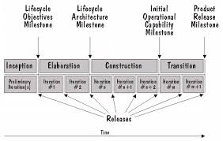
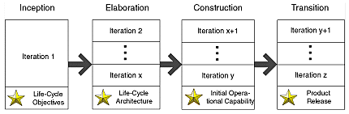
Life cycle of UP
The lifecycle describes the time dimension of project, that is, how a project is divided into phases and iterations.
It divides a project into four phases: Inception, Elaboration, Construction, and Transition, each ending with a well-defined milestone.
Each phase has specific objectives.

Slide 9
Life cycle of UP
Inception:
Establish the scope of the system, including a good understanding of what system to build, by reaching a high-level understanding of the requirements.
Mitigate many of the business risks and produce the business case for building the system and a vision document to get buy-in from all stakeholders on whether or not to proceed with the project.
This is similar to what many agile processes refer to as Iteration 0.
Elaboration:
Reduce major risks to enable cost and schedule estimates to be updated and to get buy-in from key stakeholders.
Mitigate major technical risks by taking care of many of the most technically difficult tasks.
Design, implement, test, and baseline an executable architecture, including subsystems, their interfaces, key components, and architectural mechanisms such as how to deal with interprocess communication or persistency.
Address major business risks by defining, designing, implementing, and testing key capabilities, which are validated with the customer.
Do not define and analyze all requirements at this time, as doing so would lead to waterfall development.
Detail and analyze only the requirements required to address the above risks.

Slide 10
Life cycle of UP
Construction:
Undertake a majority of the implementation as you move from an executable architecture to the first operational version of your system.
Deploy several internal and alpha releases to ensure that the system is usable and addresses user needs.
End the phase by deploying a fully functional beta version of the system, including installation and supporting documentation and training material (although the system will likely still require fine-tuning of functionality, performance, and overall quality).
Transition:
Ensure that software addresses the needs of its users by testing the product in preparation for release and making minor adjustments based on user feedback.
At this point in the lifecycle, user feedback focuses mainly on fine-tuning, configuration, installation, and usability issues; all the major structural issues should have been worked out much earlier in the project lifecycle.

Slide 11
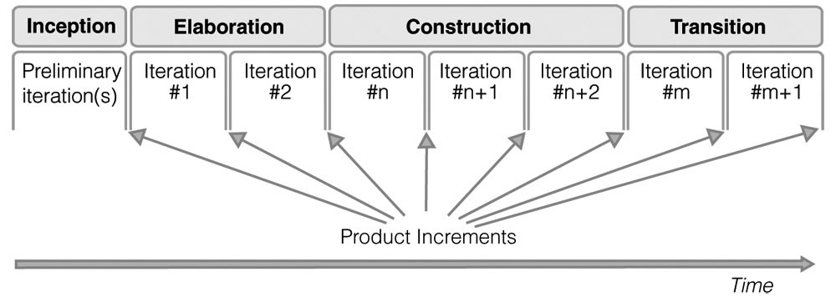
Life cycle of UP

Slide 12
Life cycle of UP
Each phase contains one or more iterations which focus on producing a product increment, that is, the working code and other deliverables necessary to achieve the business objectives of that phase.
There are as many iterations as it takes to adequately address the objectives of that phase, but no more.
If objectives cannot be adequately addressed within the planned phase, another iteration should be added to the phase, but this will delay the project.
To avoid such a delay, make sure that each iteration is sharply focused on just what is needed to achieve the business objectives of that phase, but no less.
For example, focusing too heavily on requirements in Inception is counterproductive; so is not involving stakeholders.
Each of the four phases in the Unified Process lifecycle consists of one or several iterations.
Each iteration builds on the result of previous iterations, delivering a product increment one step closer to the final release.
Product increments should include working software, with a possible exception being the product increments produced in the Inception phase for new applications.

Slide 13
Four Ps in software development
People
Project
Product
Process
PROCESS
Template
PEOPLE
Participants
PROJECT
TOOLS
Automation
Result
PRODUCT

Slide 14
Four Ps in software development
People:
The architects, developers, testers, and their supporting management, plus users, customers, and other stakeholders are the prime movers in a software project.
Project:
The organizational element through which software development is managed.
Outcome of project is a released product.
Product:
Artifacts that are created during the life of the project such as models, source code, executables and documentations
Process:
Definition of complete set of activities needed to transform user’s requirements into a product.
Is a template for creating projects.
Tools:
Software that is used to automate the activities defined in process.

Slide 15
Four Ps in software development
People:
Throughout the entire life cycle of software development, people are involved in one or another way.
So the process that guides this development must be people oriented.
Development process affect people
project feasibility
Risk management
Team structure
Project schedule
Project understandability
Sense of accomplishment
Roles will change
Uniform development process enables developers to build better software in terms of time to market, quality and cost, also to select an suitable architecture.
Here, developers will find themselves working with many other developers.
Providing guidance will result in developers “working smarter”.
To develop more effective software product, choosing right people make them effective and allow them to do what human can.

Slide 16
Four Ps in software development
Project:
Results in a new release of a product.
First project in life cycle develops and release initial system.
Successive project cycles extend the life of the system over many releases.
Throughout life cycle, a project team has to be concerned with change , iterations and the organizational pattern with in which the project is conducted.
A sequence of change
Every cycle, phase and every iteration changes the system from one thing to something else.
Each cycle leads to a release and changes continues for generations.
A series of iterations
With in each phase of cycle, series of iterations of activities are carried.
Each iteration implements set of use case or mitigates some risks.
An iteration can be thought as miniproject.
An organizational pattern
There is a pattern within which people executes a project.
The pattern indicates the type of workers the project needs and the artifacts with which it is to work.

Slide 17
Four Ps in software development
Product:
Is whole software system, not just code.
Software can be described as a binary form that can be read and understood by a computer.
It is a description that is written by programmers that can be read and understood by a compiler.
Software design in terms of subsystems, classes, interaction diagrams and other artifacts and also requirements, testing, sales etc can be viewed as part of system.
So, a system is all the artifacts that it take to represent it in machine or human readable form to the machines, the workers, and the stakeholders.

Slide 18
Four Ps in software development
Product:
Artifacts is a general term for any kind of information created , produced , changed or used by workers in developing system.
E.g. UML diagrams, prototypes, components, test plans and test procedures.
Two types:
Engineering artifacts
Created during various phases of process.
Management artifacts
Have a short lifetime.
Like business case, development plans etc.
Also include specifications of the development environment.

Slide 19
Four Ps in software development
Product:
Model is one of artifacts employed in Unified Process.
Building a system is thus a process of model building using different models to describe all the different perspective of the system.
UP provides a carefully selected set of models with which to start to satisfy those worker’s need for information.
Model is an abstraction of a system that the architects and developers build.
Each model is a self contained view of the system.

Slide 20
Four Ps in software development
Product:
Most engineering models are defined by a carefully selected subset of UML.
Like use case model consisting of use cases and actors.
There is a hierarchy of elements in model.
The system is not just collection of models but also the relationships between them as well.
Trace relationship between elements in different models add no semantic information to help understand the related model themselves, they just connect the models.

Slide 21
Four Ps in software development
Process:
In UP process refers to a concept that works as a template that can be reused by creating instances of it.
Is compare to class in object oriented paradigm from which objects can be created.
Here, process instance represents project
Software development process is a definition of complete set of activities needed to transform user’s requirements into a consistent set of artifacts that represents a software product and later to transform changes in those requirements into a new, consistent set of artifacts.
The value added result of the process is a consistent set of artifacts.
A process is a definition of a set of activities ,not their execution.

Slide 22
Four Ps in software development
Process:
We can describe a process in terms of workflows, where a workflow is a set of activities.
In UML, a workflow is a stereotype collaboration in which workers and artifacts are participants.
E.g. requirement workflow
Here, workers are: system analyst, architect , use case specifier and user interface designer .
Artifacts are: use case models, use cases and others.
No single software development process can be applied everywhere.
Unified process is a generic process that is process framework.
UP may be specialized to fit different applications and organizational needs.

Slide 23
Four Ps in software development
Process:
It is also desirable with in organization, the process be fairly consistent.
This consistency will allow components to be used interchangeably, people and managers to transfer between projects readily and accomplishment metrics to be comparable.
Factors that influence how process will differ:
Organizational factors
Domain factors
Life cycle factors
Technical factors

Slide 24
Four Ps in software development
Process:
Benefits:
Everyone on the development team can understand what to do.
Developers can better understand what other developers are doing.
Supervisors and Managers even those who cannot read code, can, thanks to architectural drawing, understand what developers are doing.
Developers , supervisors and managers can transfer between projects or divisions without having learn a new process.
Training can be standardized within a company.
The course of software development is repeatable.

Slide 25
Four Ps in software development
Tools:
Tools are integral to the process.
Are good at automating repetitive tasks, keeping things structured, managing large amount of information and guiding along a particular development path.
The tools that implement an automated process should be easy to use.
There has to be balance between process and tools.
On one hand ,process drives tool development.
On the other hand, tools guide process development.
Successful development of process automation (tools) cannot be achieved without the parallel development of the process framework in which the tools are to function.

Slide 26
Business Modeling
Business process modeling (BPM) in systems engineering is the activity of representing processes of an enterprise, so that the current process may be analyzed or improved.
BPM is typically performed by business analysts, who provide expertise in the modeling discipline; by subject matter experts, who have specialized knowledge of the processes being modeled; or more commonly by a team comprising both.
Alternatively, the process model can be derived directly from events' logs using process mining tools.
The business objective is often to increase process speed or reduce cycle time; to increase quality; or to reduce costs, such as labor, materials, scrap, or capital costs.
In practice, a management decision to invest in business process modeling is often motivated by the need to document requirements for an information technology project.
In the field of software engineering, the term 'business process modeling' opposed the common software process modeling, aiming to focus more on the state of the practice during software development.
In that time (early 1990s) all existing and new modeling techniques to illustrate business processes were consolidated as 'business process modeling languages.
In the Object Oriented approach, it was considered to be an essential step in the specification of business application systems.

Slide 27
Business Modeling
Business process modeling became the base of new methodologies, for instance those that supported data collection, data flow analysis, process flow diagrams and reporting facilities.
A business model is a framework for creating economic, social, and/or other forms of value.
The term 'business model' is thus used for a broad range of informal and formal descriptions to represent core aspects of a business, including purpose, offerings, strategies, infrastructure, organizational structures, trading practices, and operational processes and policies.
In the most basic sense, a business model is the method of doing business by which a company can sustain itself. That is, generate revenue.
The business model spells-out how a company makes money by specifying where it is positioned in the value chain.

Slide 28
Business Modeling
A business process is a collection of related, structured activities or tasks that produce a specific service or product (serve a particular goal) for a particular customer or customers.
There are three main types of business processes:
Management processes, that govern the operation of a system.
Typical management processes include corporate governance and strategic management
Operational processes, that constitute the core business and create the primary value stream.
Typical operational processes are purchasing, manufacturing, marketing, and sales.
Supporting processes, that support the core processes.
Examples include accounting, recruitment, and technical support.

Slide 29
Business Modeling
A business process can be decomposed into several sub-processes, which have their own attributes, but also contribute to achieving the goal of the super-process.
The analysis of business processes typically includes the mapping of processes and sub-processes down to activity level.
A business process model is a model of one or more business processes, and defines the ways in which operations are carried out to accomplish the intended objectives of an organization.
Such a model remains an abstraction and depends on the intended use of the model.
It can describe the workflow or the integration between business processes.
It can be constructed in multiple levels.
A workflow is a depiction of a sequence of operations, declared as work of a person, of a simple or complex mechanism, of a group of persons, of an organization of staff, or of machines.
Workflow may be seen as any abstraction of real work, segregated into workshare, work split or other types of ordering.
For control purposes, workflow may be a view of real work under a chosen aspect.

Slide 30
Business Modeling
The artifact-centric business process model has emerged as a holistic approach for modeling business processes, as it provides a highly flexible solution to capture operational specifications of business processes.
It particularly focuses on describing the data of business processes, known as “artifacts”, by characterizing business-relevant data objects, their lifecycles, and related services.
The artifact-centric process modelling approach fosters the automation of the business operations and supports the flexibility of the workflow enactment and evolution.
Business process modeling tools provide business users with the ability to model their business processes, implement and execute those models, and refine the models based on as-executed data.
As a result, business process modeling tools can provide transparency into business processes, as well as the centralization of corporate business process models and execution metrics.

Slide 31
Business Modeling
A business model, which may be considered an elaboration of a business process model, typically shows business data and business organizations as well as business processes.
By showing business processes and their information flows a business model allows business stakeholders to define, understand, and validate their business enterprise.
The data model part of the business model shows how business information is stored, which is useful for developing software code.
Usually a business model is created after conducting an interview, which is part of the business analysis process.
The interview consists of a facilitator asking a series of questions to extract information about the subject business process.
The interviewer is referred to as a facilitator to emphasize that it is the participants, not the facilitator, who provide the business process information. Although the facilitator should have some knowledge of the subject business process, but this is not as important as the mastery of a pragmatic and rigorous method interviewing business experts.

Slide 32
Business Modeling
The method is important because for most enterprises a team of facilitators is needed to collect information across the enterprise, and the findings of all the interviewers must be compiled and integrated once completed.
Business models are developed as defining either the current state of the process, in which case the final product is called the "as is" snapshot model, or a concept of what the process should become, resulting in a "to be" model. By comparing and contrasting "as is" and "to be" models the business analysts can determine if the existing business processes and information systems are sound and only need minor modifications, or if reengineering is required to correct problems or improve efficiency.

Slide 33
Requirement analysis
It is a statement that identifies a necessary attribute, capability, characteristic, or quality of a system for it to have value and utility to a customer, organization, internal user, or other stakeholder.
A requirement specification (often imprecisely referred to as the spec, because there are different sorts of specifications) refers to an explicit set of requirements to be satisfied by a material, design, product, or service.
In the classical engineering approach, sets of requirements are used as inputs into the design stages of product development.
Requirements are also an important input into the verification process, since tests should trace back to specific requirements.
Requirements show what elements and functions are necessary for the particular project.
However, when iterative methods of software development or agile methods are used, the system requirements are incrementally developed in parallel with design and implementation.
Product requirements prescribe properties of a system or product.
Process requirements prescribe activities to be performed by the developing organization.
For instance, process requirements could specify the methodologies that must be followed, and constraints that the organization must obey.

Slide 34
Requirement analysis
Types of requirements:
Architectural requirements:
Architectural requirements explain what has to be done by identifying the necessary systems structure and systems behavior, i.e., systems architecture of a system.
Business requirements:
High-level statements of the goals, objectives, or needs of an organization. They usually describe opportunities that an organization wants to realise or problems that they want to solve. Often stated in a business case.
User (stakeholder) requirements:
Mid-level statements of the needs of a particular stakeholder or group of stakeholders. They usually describe how someone wants to interact with the intended solution. Often acting as a mid-point between the high-level business requirements and more detailed solution requirements.

Slide 35
Requirement analysis
Types of requirements:
Functional (solution) requirements:
Usually detailed statements of capabilities, behaviour, and information that the solution will need. Examples include formatting text, calculating a number, modulating a signal. They are also known as capabilities.
Quality-of-service (non-functional) requirements
Usually detailed statements of the conditions under which the solution must remain effective, qualities that the solution must have, or constraints within which it must operate. Examples include: reliability, testability, maintainability, availability. They are also known as characteristics, constraints.
Implementation (transition) requirements
Usually detailed statements of capabilities or behaviour required only to enable transition from the current state of the enterprise to the desired future state, but that will thereafter no longer be required. Examples include: recruitment, role changes, education, migration of data from one system to another.

Slide 36
Requirement analysis
Characteristics of good requirements:
Unitary
Complete
Consistent
Traceable
Unambiguous
Verifiable
Requirements analysis or requirements engineering is the set of activities that lead to the derivation of the system or software requirements.
Requirements engineering may involve a feasibility study or a conceptual analysis phase of the project and requirements elicitation (gathering, understanding, reviewing, and articulating the needs of the stakeholders) and requirements analysis , analysis (checking for consistency and completeness), specification (documenting the requirements) and validation (making sure the specified requirements are correct).
Requirements analysis is critical to the success of a systems or software project. The requirements should be documented, actionable, measurable, testable, traceable, related to identified business needs or opportunities, and defined to a level of detail sufficient for system design.

Slide 37
Analysis and Design
Object-oriented analysis and design (OOAD) is a popular technical approach for analyzing, designing an application, system, or business by applying the object-oriented paradigm and visual modeling throughout the development life cycles to foster better stakeholder communication and product quality.
OOAD in modern software engineering is best conducted in an iterative and incremental way.
Iteration by iteration, the outputs of OOAD activities, analysis models for OOA and design models for OOD respectively, will be refined and evolve continuously driven by key factors like risks and business value.
The primary tasks in object-oriented analysis (OOA) are:
Find the objects
Organize the objects
Describe how the objects interact
Define the behavior of the objects
Define the internals of the objects

Slide 38
Analysis and Design
Common models used in OOA are use cases and object models.
Use cases describe scenarios for standard domain functions that the system must accomplish.
Object models describe the names, class relations (e.g. Circle is a subclass of Shape), operations, and properties of the main objects.
User-interface prototypes can also be created to help understanding.
During object-oriented design (OOD), a developer applies implementation constraints to the conceptual model produced in object-oriented analysis.
Important topics during OOD also include the design of software architectures by applying architectural patterns and design patterns with object-oriented design principles.
OOM is a main technique heavily used by both OOA and OOD activities in modern software engineering.

Slide 39
Implementation
Implementation is the realization of an application, or execution of a plan, idea, model, design, specification, standard, algorithm, or policy.
an implementation is a realization of a technical specification or algorithm as a program, software component, or other computer system through computer programming and deployment.
in object-oriented programming, when a concrete class implements an interface; in this case the concrete class is an implementation of the interface and it includes methods which are implementations of those methods specified by the interface.

Slide 40
Test
The purposes of testing are:
To verify the interaction between objects.
To verify the proper integration of all components of the software.
To verify that all requirements have been correctly implemented.
To identify and ensure defects are addressed prior to the deployment of the software.
The Rational Unified Process proposes an iterative approach, which means that you test throughout the project.
This allows you to find defects as early as possible, which radically reduces the cost of fixing the defect.
Tests are carried out along three quality dimensions reliability, functionality, application performance and system performance.
For each of these quality dimensions, the process describes how you go through the test lifecycle of planning, design, implementation, execution and evaluation.
Strategies for when and how to automate test are described. Test automation is especially important using an
iterative approach, to allow regression testing at then end of each iteration, as well as for each new version of the
product.

Slide 41
Deployment
Software deployment is all of the activities that make a software system available for use.
The general deployment process consists of several interrelated activities with possible transitions between them.
These activities can occur at the producer side or at the consumer side or both. Because every software system is unique, the precise processes or procedures within each activity can hardly be defined.
Therefore, "deployment" should be interpreted as a general process that has to be customized according to specific requirements or characteristics.

Slide 42
Deployment
Deployment activities:
Release
Install and activate
Deactivate
Adapt
Update
Version tracking
Uninstall

Slide 43
Configuration and change management
Configuration management (CM) is a systems engineering process for establishing and maintaining consistency of a product's performance, functional and physical attributes with its requirements, design and operational information throughout its life.
CM verifies that a system performs as intended, and is identified and documented in sufficient detail to support its projected life cycle.
CM emphasizes the functional relation between parts, subsystems, and systems for effectively controlling system change.
It helps to verify that proposed changes are systematically considered to minimize adverse effects.
CM verifies that changes are carried out as prescribed and that documentation of items and systems reflects their true configuration.
A complete CM program includes provisions for the storing, tracking, and updating of all system information on a component, subsystem, and system basis.

Slide 44
Configuration and change management
CM is the practice of handling changes systematically so that a system maintains its integrity over time.
CM implements the policies, procedures, techniques, and tools that are required to manage, evaluate proposed changes, track the status of changes, and to maintain an inventory of system and support documents as the system changes.
CM programs and plans provide technical and administrative direction to the development and implementation of the procedures, functions, services, tools, processes, and resources required to successfully develop and support a complex system.
Change Management focuses on how people and teams are affected by an organizational transition.
It deals with many different disciplines, from behavioral and social sciences to information technology and business solutions.
In a project management context, change management may refer to the change control process wherein changes to the scope of a project are formally introduced and approved.

Slide 45
Project Management
Project management is the discipline of initiating, planning, executing, controlling, and closing the work of a team to achieve specific goals and meet specific success criteria.
A project is a temporary endeavor designed to produce a unique product, service or result with a defined beginning and end (usually time-constrained, and often constrained by funding or deliverables) undertaken to meet unique goals and objectives, typically to bring about beneficial change or added value.
The primary challenge of project management is to achieve all of the project goals and constraints.

Slide 46
Project Management
Agile project management encompasses several iterative approaches based on the principles of human interaction management and founded on a process view of human collaboration.
It is the most consistent project management technique since it involves frequent testing of the project under development.
It is the only technique in which the client will be actively involved in the project development.
The only disadvantage with this technique is that it should be used only if the client has enough time to be actively involved in the project.

Slide 47
Environment
Environment discipline refers to the tools and customizing the process for the project - that is, setting up the tool and process environment

Slide 48
Models evolution through Itertions
Design in Unified Process proceeds through a series of cycles, each of which has following phases:
Inception
Elaboration
Construction
Transition
Within these phases we may go through a number of iterations, each involving the normal forms of workflow activity(requirements , analysis , design , implementation , testing).
A principal product of the unified process is the series of models, each appropriate to a key stage in system design.
Since many different models are produced, each for a different design purpose but all related to the same system, we need some point of anchorage.
This is provided by a use case model.

Slide 49
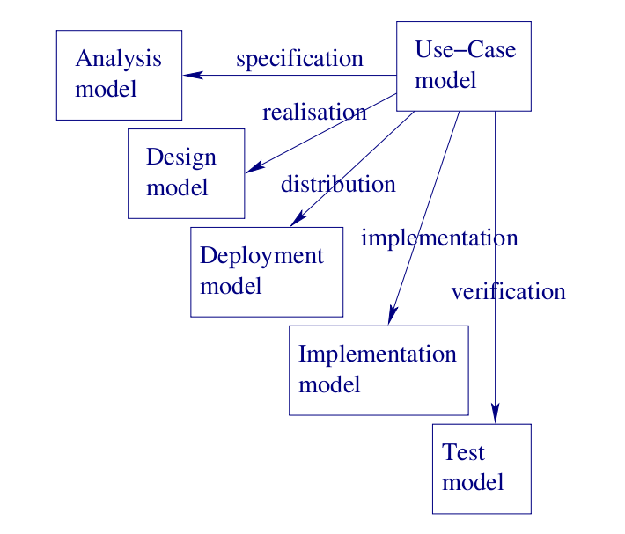
Models evolution through Itertions

Slide 50
Models evolution through Itertions
The purpose of use case is to describe the functionality required of the system from the point of view of those concerned with its operation.
The way a use case does this is by specifying a sequence of actions , including variants, that the system can perform and that yield an observable result of value to some actor.
In unified process, this drives:
Requirement capture
Analysis and Design of how system realizes use case
Acceptance / system testing
Planning of development tasks
Traceability of design decisions back to use cases

Slide 51
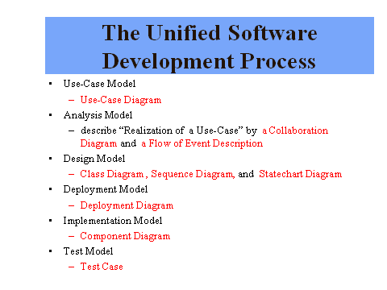
Models evolution through Itertions

Slide 52
Models evolution through Itertions

